Slide 1
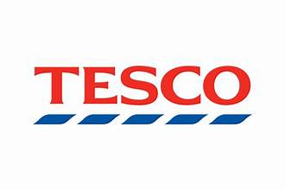
STRATEGY REVIEW
Tesco: Pricing, Profitability
& Competitive Strategy
How can Tesco remain price-competitive while protecting sustainable profits?
CM Sanjai Kanna CM October 2026

Slide 2
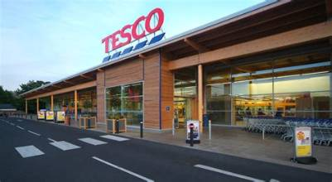
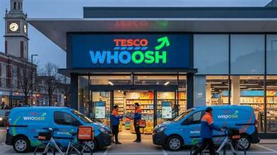
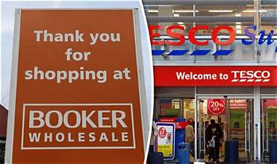
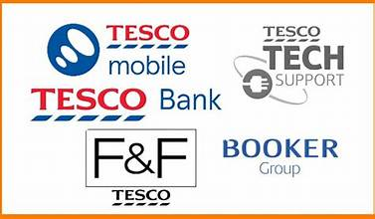
Tesco at a glance
Tesco is a UK grocery retailer operating across large stores, convenience, online and wholesale. This analysis focuses on how pricing choices affect customer value and profitability.
Retail stores
Online
Wholesale
Other activities
Online grocery and rapid delivery extend convenience beyond stores.
Booker serves independent retailers and food-service customers.
F&F, retail media and other services diversify the business.
Large stores and convenience formats serve different shopping missions.
2 | 12

Slide 3
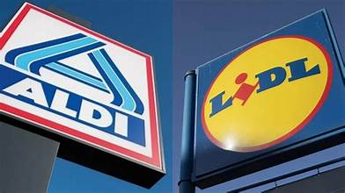

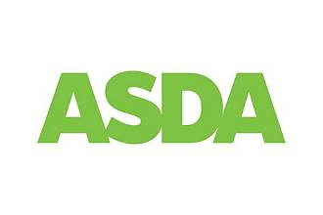
The competitive pressure on Tesco
Aldi and Lidl
Discount retailers compete through sharp everyday prices and focused ranges. A like-for-like basket comparison is needed to quantify Tesco’s price gap.
Sainsbury’s
Competes across value, quality and loyalty through its own price and promotion strategy. Compare matched products and dates before drawing price conclusions.
Asda
Competes on grocery price and family-shop value. Its relative position should be tested using a consistent basket, pack size and promotion basis.
CVS
Online grocery
Online retailers and rapid-delivery services compete on convenience as well as price. Tesco’s response includes online grocery and Whoosh.
3 | 12

Slide 4
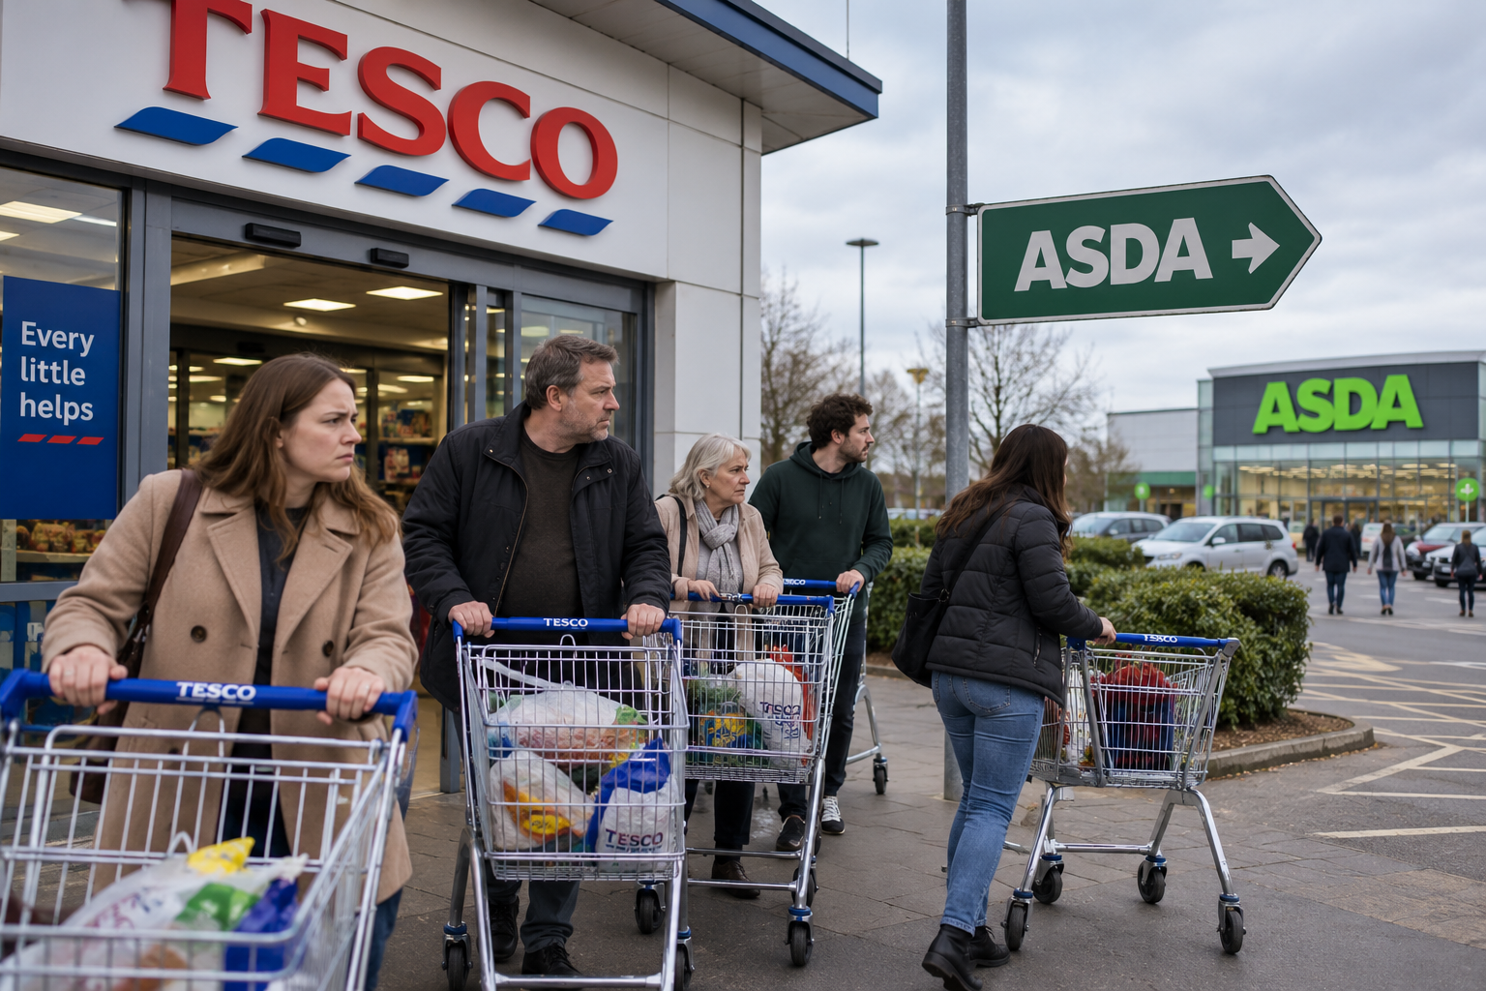

What problem are we trying to solve?
The business problem
Tesco needs to offer credible value to retain customers while ensuring that discounts generate enough incremental demand or strategic benefit to justify the contribution given up.
If prices are too high
If prices are cut too deeply
Customers may switch to rivals, putting sales and market share at risk.
If prices are cut without enough incremental demand, contribution per unit falls and total profit can weaken.
4 | 12

Slide 5
What is Tesco’s current pricing strategy?
Aldi Price Match
Price-match selected everyday products against Aldi to signal value on items customers readily compare. The impact should be tested on matched products.
Everyday Low Prices
Maintain competitive shelf prices on selected lines, reducing reliance on temporary discounts as the only value signal.
Clubcard Prices
Offer loyalty-linked discounts. Evaluate whether each offer changes buying behaviour or subsidises purchases customers would have made anyway.
Tesco Finest
Offer a premium range that supports customer choice and mix. Do not assume premium sales automatically fund price investment without incremental profit evidence.
5 | 12

Slide 6
Sales grew faster than adjusted operating profit
GROUP SALES
ADJUSTED OPERATING PROFIT
SALES–PROFIT GROWTH GAP
FREE CASH FLOW
+4.6%
+0.8%
3.8 pp
+11.8%
£63.636bn → £66.588bn
£3.128bn → £3.152bn
Sales growth +4.6%; adjusted operating profit growth +0.8%
£1.750bn → £1.957bn
CUSTOMER / COMPETITIVE SIGNALS
WHAT THE DATA ACTUALLY MEANS
UK like-for-like sales grew 4.2%; UK market share rose 24 bps to 28.5%. Tesco reported £535m delivered through Save to Invest. These figures describe performance; they do not isolate the effect of pricing.
Sales and customer indicators strengthened, while adjusted operating profit grew more slowly than sales. This supports testing the return on price investment, but does not prove price cuts caused the growth gap. Inflation, mix and other costs may also contribute.
6 | 12

Slide 7
What the public evidence shows—and what it cannot prove
SUPPORTED BY THE ANNUAL REPORT
STRATEGIC INTERPRETATION
NOT PROVEN BY PUBLIC DATA
• Targeted price investment responded to greater UK competition.
• Price investment appears consistent with stronger volumes and market-share gains.
• Exact incremental units caused by each price reduction.
• UK LFL sales grew 4.2%; UK share rose to 28.5%.
• Productivity savings helped fund customer investment and absorb cost inflation.
• Whether promotions grow total contribution or shift purchases between products.
• Save to Invest delivered c.£535m.
• Slower profit growth and lower margin make returns discipline worth investigating.
• SKU/category-level price elasticity and competitor price gaps.
• Cost pressures included higher National Insurance contributions and the EPR levy.
• Net profit impact by offer after discounts, cannibalisation and execution costs.
Conclusion: public evidence supports a pricing-return diagnostic; it does not prove that pricing alone caused margin pressure.
7 | 12

Slide 8
What Tesco would need to decide where price investment pays back
DIAGNOSTIC LENS
Competitor prices on matched products; customer price-perception data by segment.
DECISION IT ENABLES
Price perception
Which products need investment to defend value perception?
Which items genuinely need price investment to defend value perception?
Incremental demand
Weekly product/store units, test and control stores, repeat rate and basket effects.
Did the offer create incremental demand or subsidise existing purchases?
Contribution economics
Net price after discount, unit cost, waste/markdown, fulfilment and cannibalisation effects.
Does incremental contribution cover lost margin and offer costs?
Funding capacity
Savings achieved versus plan, cost trends and costs required to realise savings.
How much investment can be funded without relying on unverified savings?
Decision rule: proceed only when measured incremental contribution and evidenced strategic benefits justify the full net cost.
8 | 12

Slide 9
Illustrative pricing model and pilot decision
BEFORE
AFTER 5% CUT
BREAK-EVEN HURDLE
£1.00 price − £0.70 cost
£0.95 price − £0.70 cost
1.20×
£0.30 contribution / unit
£0.25 contribution / unit
A 20% volume increase only maintains contribution before additional execution costs, cannibalisation or changes in cost.
1 · DESIGN
2 · TEST
3 · SCALE / STOP
Select products using measured competitor gaps, customer evidence and category importance. Define test and matched control stores before launch.
Compare test and control results; account for seasonality, media, distribution and cannibalisation where data allow.
Scale only if the test demonstrates positive incremental value against a pre-agreed hurdle; otherwise stop or redesign.
MEASURE
MEASURE
MEASURE
Record baseline price, units, contribution, availability, waste and other promotions.
Track incremental units, net contribution, basket size and repeat purchase against the control.
Review realised contribution, execution cost, operational feasibility and customer/value perception.
Net impact = incremental contribution − margin lost on existing units − offer/execution costs + verified, attributable savings.
9 | 12

Slide 10
Key risks and how to manage them
Price-war escalation
Cost inflation
Weak loyalty response
Competitors may respond with deeper cuts. Limit investment to products where the price gap and customer response justify the cost.
Wage, energy or supply costs may outpace savings. Reforecast the funding envelope and do not commit unverified savings.
Discounts may subsidise existing purchases. Use test/control measurement to estimate incremental demand and contribution.
Low-return promotions
Savings not realised
Value perception
Sales can rise while contribution falls. Track net contribution after discounts, cannibalisation and execution costs.
Productivity gains may miss plan. Release price-investment funding only against verified savings or approved budgets.
Too many temporary offers may confuse value signals. Monitor customer perception alongside offer-level returns.
10 | 12

Slide 11
Recommended management actions
Recommendation
Key measurable KPI
Test selected price investments before scaling
Incremental contribution versus matched control; units and net price
Evaluate Clubcard offers for incremental value
Incremental basket contribution, repeat purchase and redemption—not redemption alone
Fund investment only from evidenced savings
Savings delivered versus plan, net of costs to realise them
Stop or redesign promotions below the return hurdle
Net contribution by offer after discounts, cannibalisation and execution costs
Treat premium and adjacent growth as a hypothesis
Incremental profit contribution from Finest, retail media, Booker and services
11 | 12

Slide 12
CONCLUSION
How can Tesco compete on price while protecting sustainable profit?
What Tesco can do?
Fund investment only through verified savings or approved budgets.
Invest selectively where customer response is evidenced.
Measure incremental contribution against a control.
The public data justify a disciplined test not a claim that a specific price strategy has already improved profit.

